Slide 1



🚀 Azure Terraform Setup Guide (Backend + Key Vault + Pipeline)
Author: Denis Bell
Created with Pi

Slide 2

CONTENTS
01
02
03
📋 Prerequisites
🛠 Step 1: Create Terraform Backend (State Storage)
🔐 Step 2: Create Key Vault & Secrets
04
05
06
🔌 Step 3: Create Service Connection
📦 Step 4: Create Variable Group
🚀 Step 5: Run Pipeline
07
08
⚠️ First Run Permission
✅ Summary

Slide 3
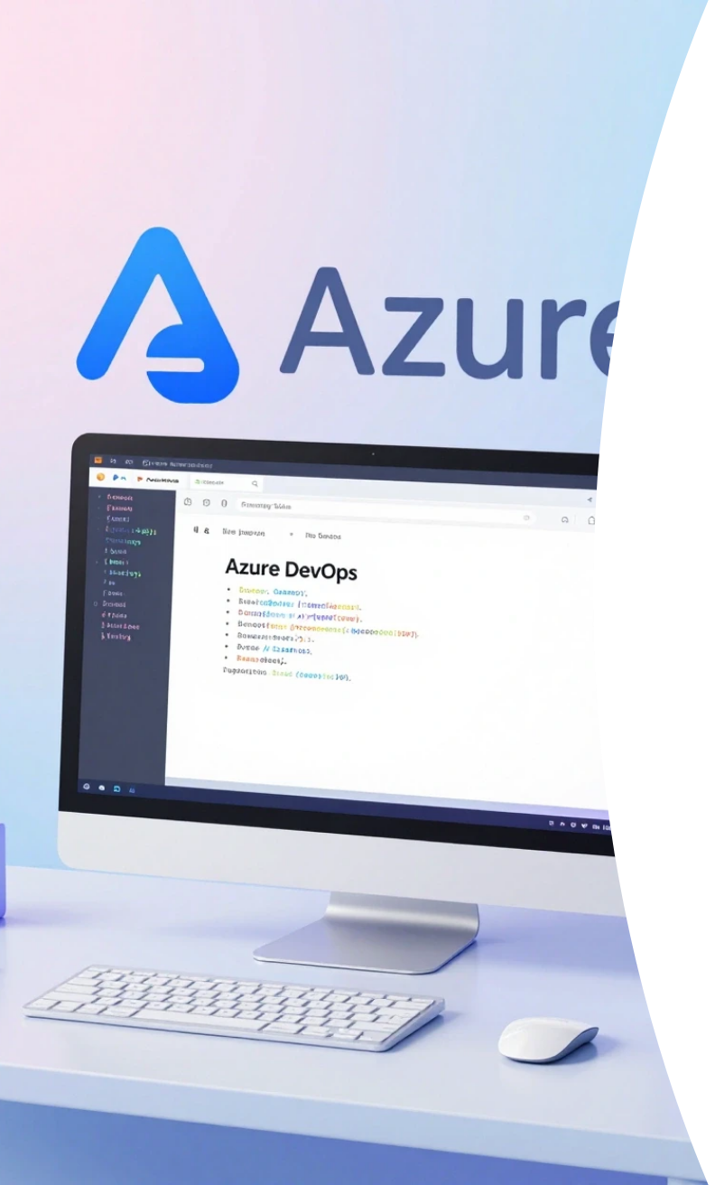





📋 Prerequisites
Azure CLI installed and logged in
az login
1
Azure DevOps project created
2
Bash terminal (WSL, Linux, or Git Bash)

Slide 4

🛠 Step 1: Create Terraform Backend (State Storage)
Goal: Create the Resource Group and Storage Account where Terraform will save its state file (petclinic.tfstate).
chmod +x create-backend.sh ./create-backend.sh
Copy the Storage Account name from the output.

Slide 5








🔐 Step 2: Create Key Vault & Secrets
Update create-keyvault-and-secrets.sh:
1
2
3
KV_NAME (globally unique)
STORAGE_ACCOUNT (from Step 1)
SERVICE_CONN (Azure DevOps connection name)
Run:
chmod +x create-keyvault-and-secrets.sh ./create-keyvault-and-secrets.sh
Verify in Azure Portal → Key Vaults.

Slide 6
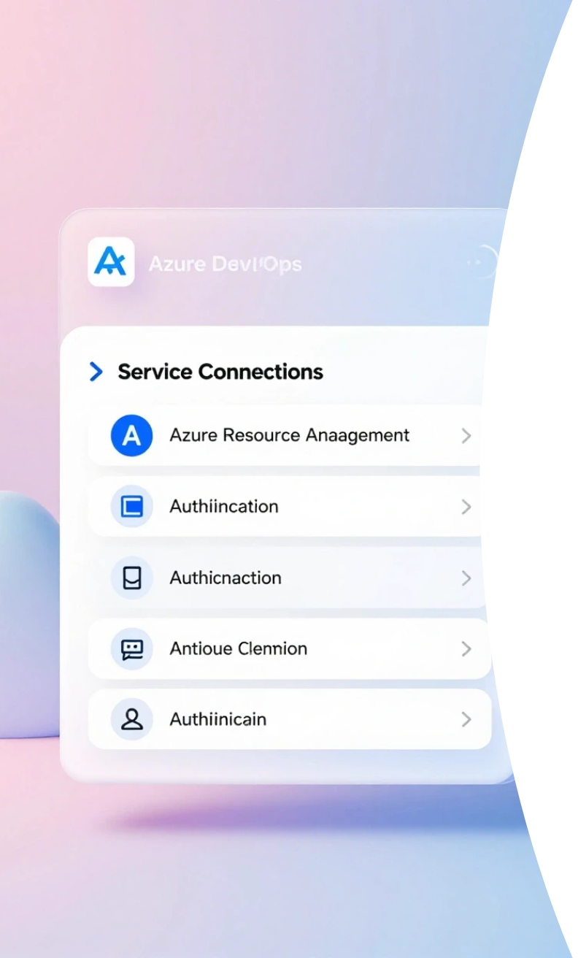






🔌 Step 3: Create Service Connection
Azure DevOps → Project Settings → Pipelines → Service Connections
Create:
1
Type
2
Auth
3
Resource Group
Azure Resource Manager
Service principal (automatic)
rg-tfstate
4
Name
5
Grant access
terraform-service-connection-2
Enabled

Slide 7




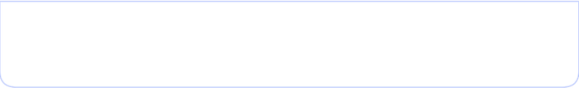



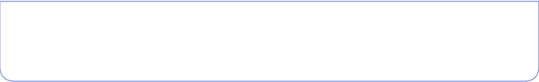

📦 Step 4: Create Variable Group
Pipelines → Library → Variable Groups
1
2
Name
Link to Key Vault
terraform-prod-vars
Enabled
3
4
Service Connection
Key Vault
terraform-service-connection-2
kv-petclinic-prod-xoa
Add all secrets.

Slide 8

🚀 Step 5: Run Pipeline
Ensure azure-pipelines.yml:
variables: - name: azureServiceConnection value: 'terraform-service-connection-2' - group: terraform-prod-vars
Push code and run pipeline.

Slide 9
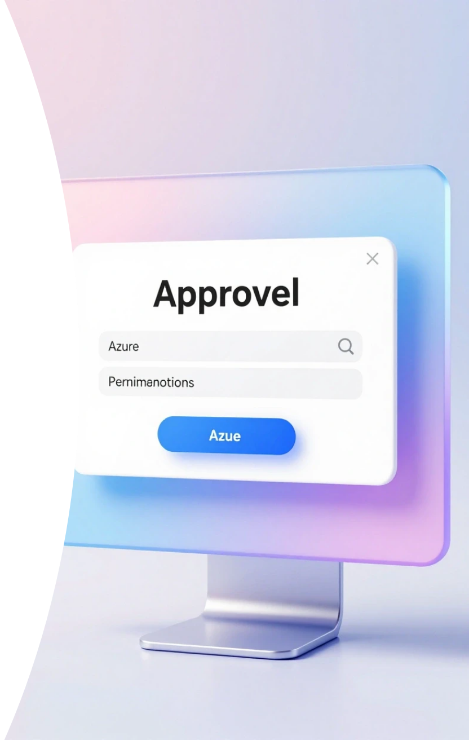
⚠️ First Run Permission
Approve permission when prompted.

Slide 10





✅ Summary
Secure backend
Centralized secrets
Automated authentication
CI/CD ready

Slide 11

Thank You

